Slide 1


Techlabnews
Actions report in GitHub repositories
Emmanuel COLUSSI
Solution Architect

Slide 2

Know when an action is done on a repository in our organization.
The code added to our repositories must be properly reviewed
CUSTOMER
ISSUE

Slide 3

TECHNICAL SOLUTION PROPOSED
Use the github webhook mechanism
Ready-to-use parameters in Organization
Set Protection on the default Repository branch

Slide 4



TECHNICAL SOLUTION PROPOSED
What are Webhooks ?
Webhooks are the ways of communicating between two apps by sending notifications or alerts when something happens. Webhooks are automated messages sent from apps during any event. They have a payload or message, which is sent to a unique URL.
When an event happens on the trigger application, it serializes the data about that event and sends it to a Webhook URL from the action application. This is defined as the one you want to do something based on the data collated from the first application.
Webhooks can be installed in an organization, in a specific repository or in a GitHub application. Once installed, the webhook is sent whenever one or more subscriber events occur.

Slide 5
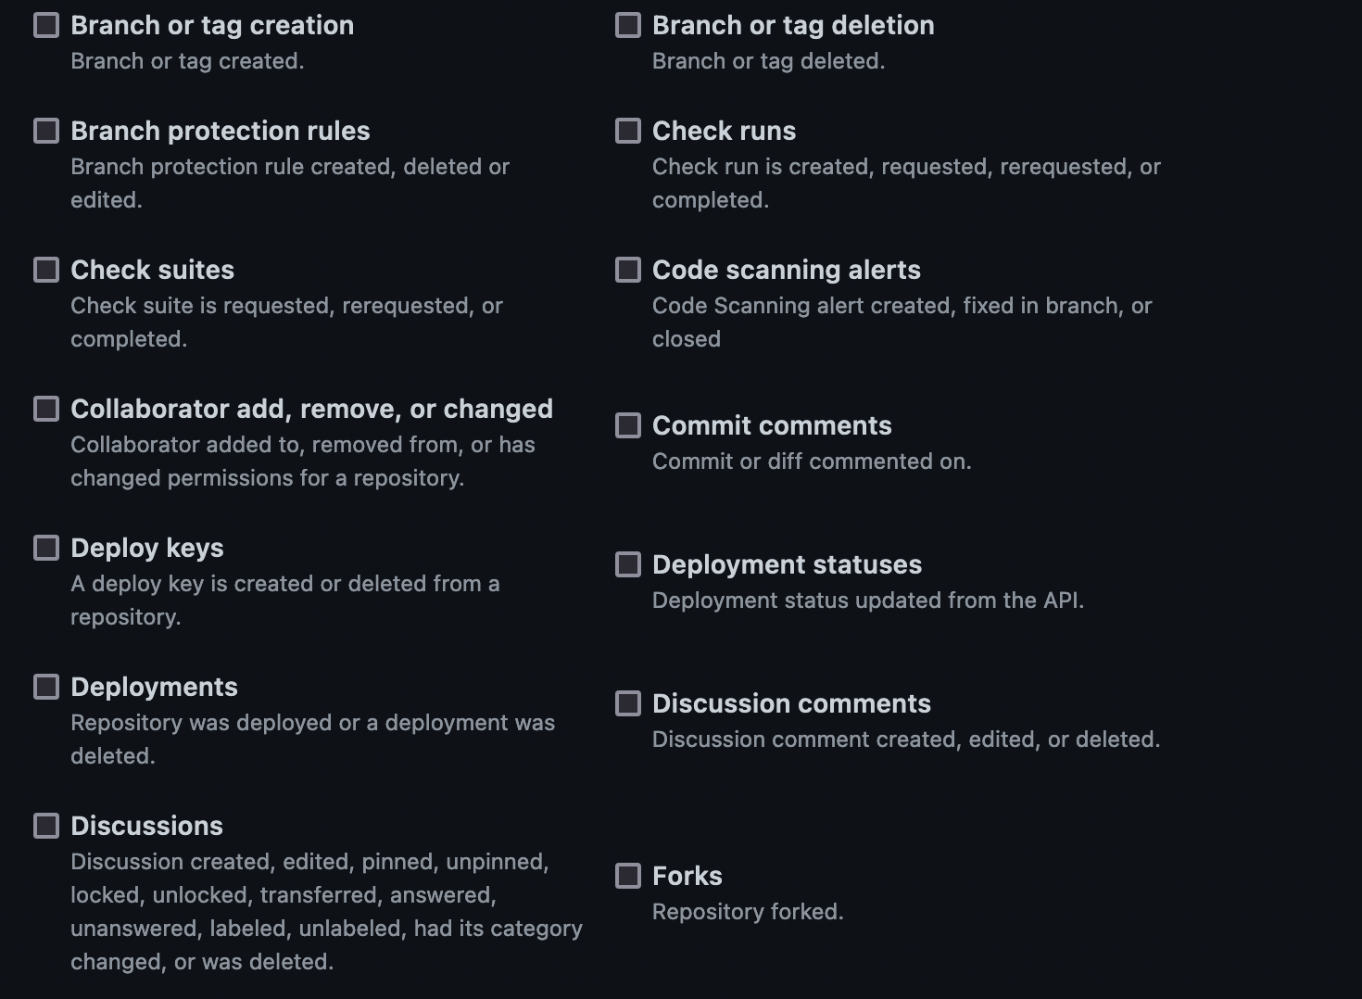
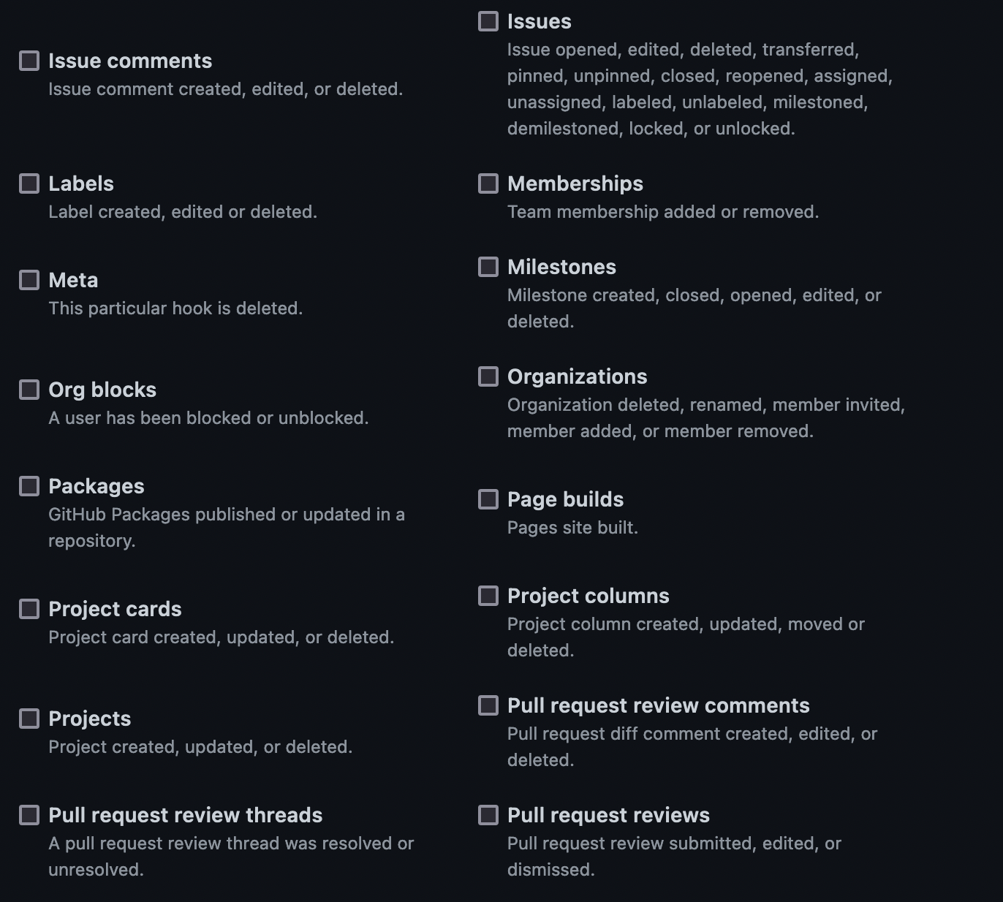
TECHNICAL SOLUTION PROPOSED : events in organization

Slide 6
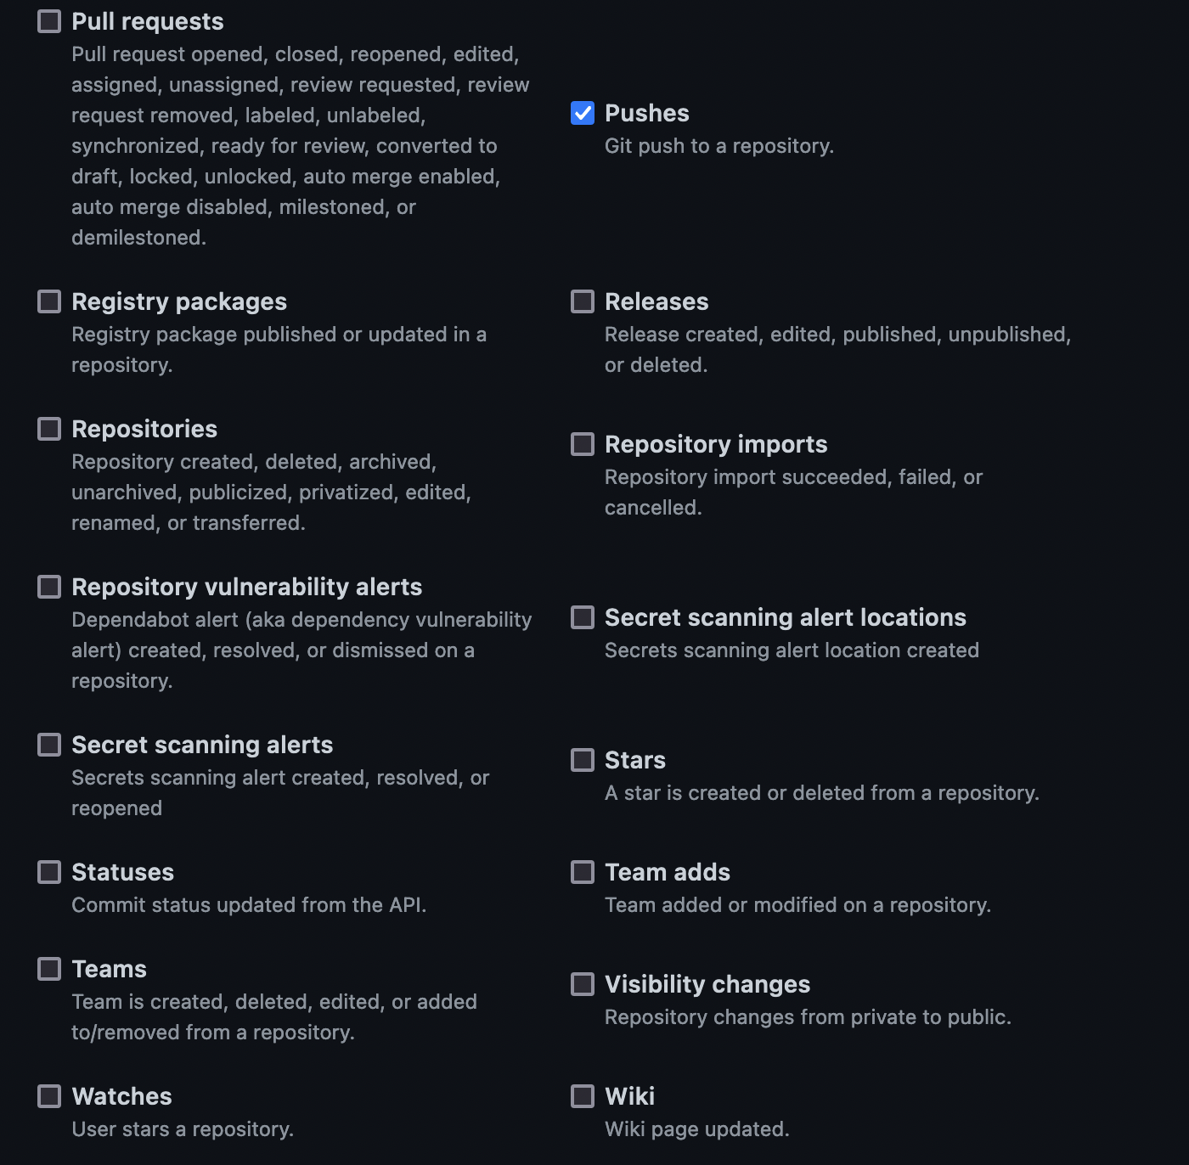
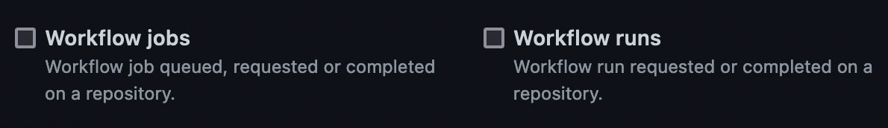
TECHNICAL SOLUTION PROPOSED : events in organization

Slide 7





TECHNICAL SOLUTION PROPOSED
GitHub
Organization - Repos
GitHub Webhook message
(HTTP POST Request)
Trap event :
GitHub Webhook
Send message
{JSON}
{JSON}
Set Security Rules
Create message Issue
Push README.md
Record event in Database
{JSON}
Create repos
push
App Endpoint
User
operations
Show events Dashboard

Slide 8
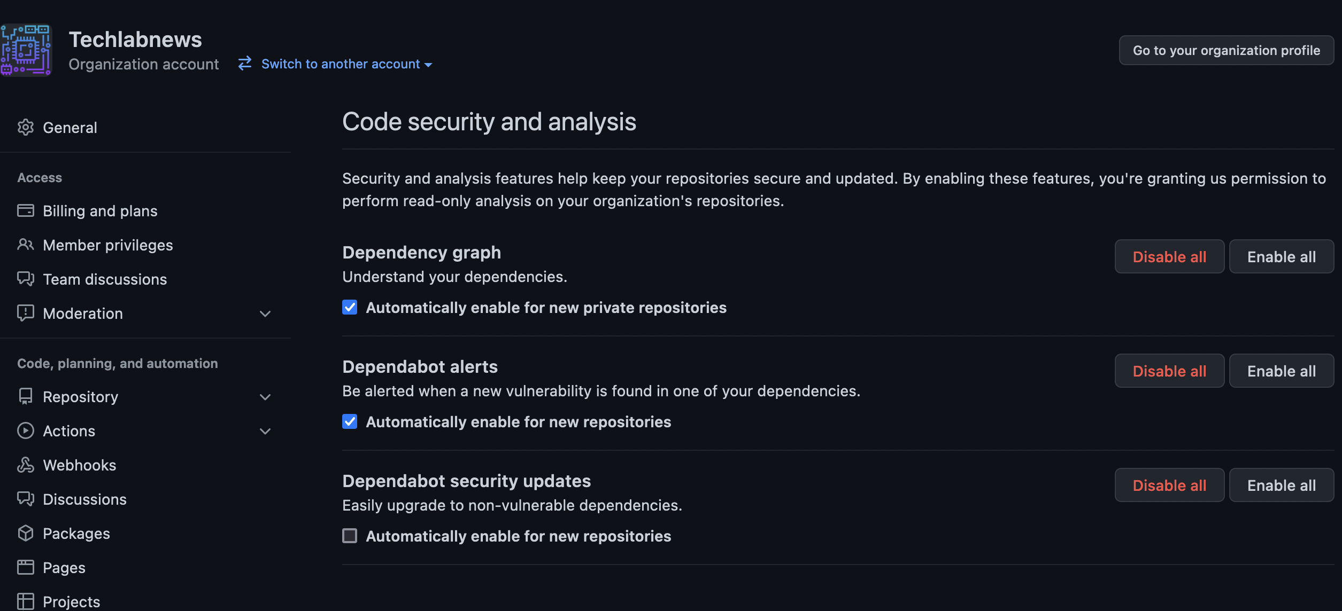
TECHNICAL SOLUTION PROPOSED : Ready-to-use parameters

Slide 9
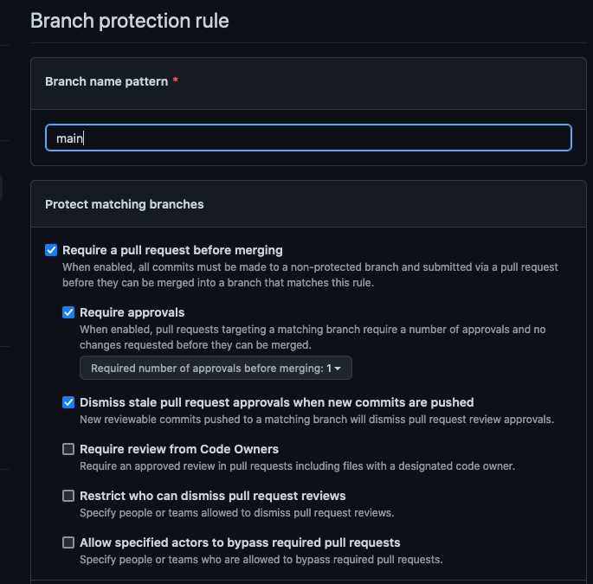

TECHNICAL SOLUTION PROPOSED : Protection on the default Repository branch
Create a automatic new Branch protection rule

Slide 10
2. EXTRA RESOURCES
DEMONSTRATION

Slide 11
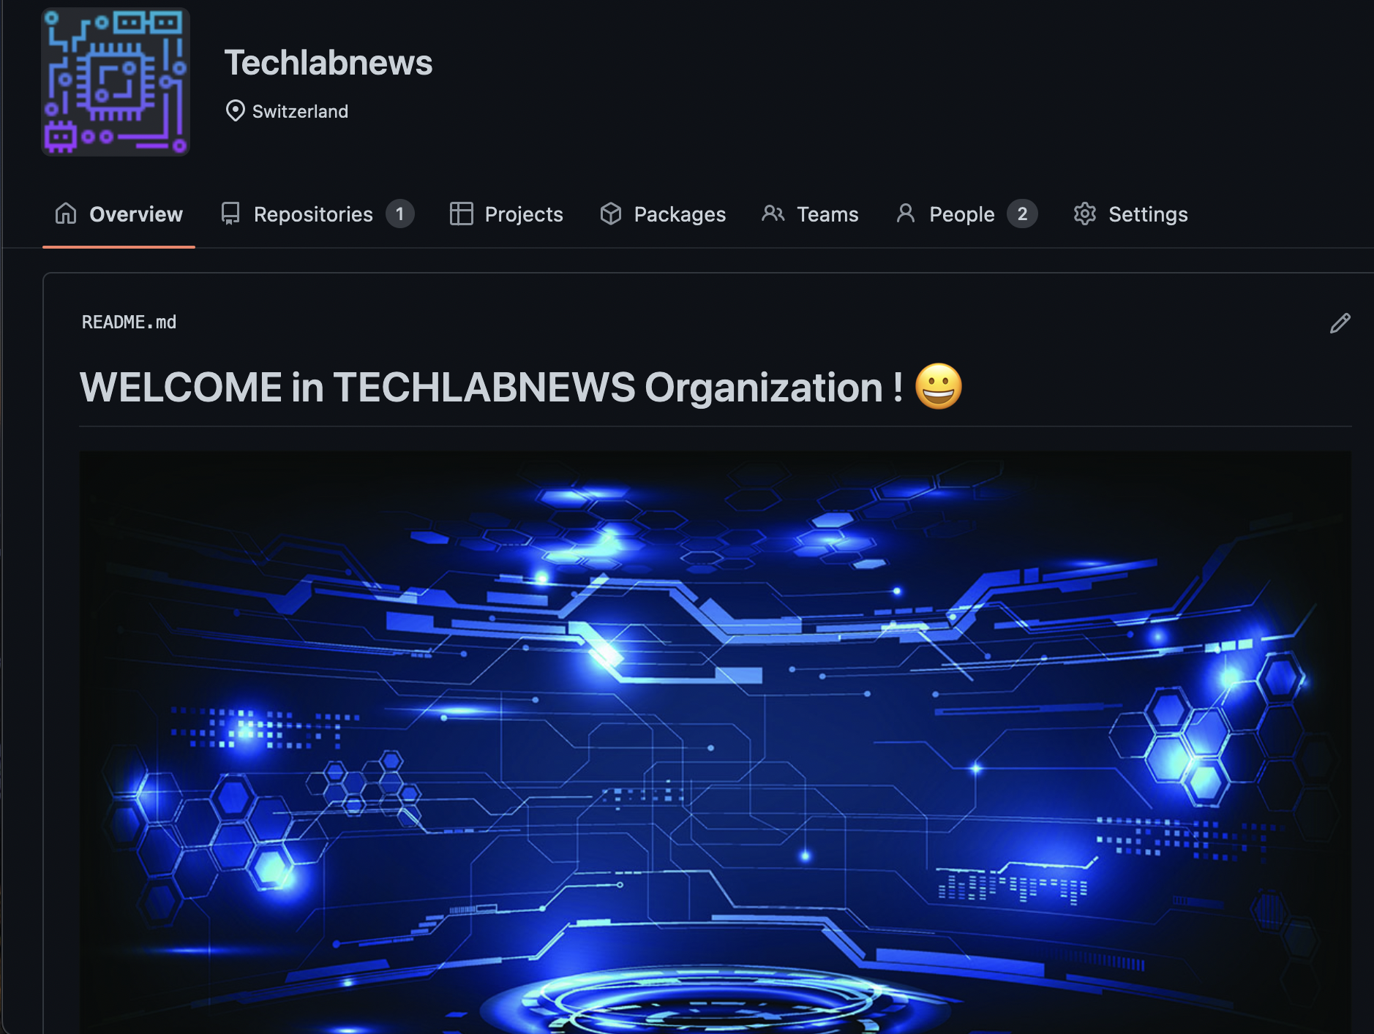
TECHNICAL SOLUTION PROPOSED : Demonstration
We have a GitHub organization
We will capture events on the organization:
- pushes
Send events
- Repositories : create,delete ….
App RepMonitorWebHook

Slide 12

TECHNICAL SOLUTION PROPOSED : demo
GitHub
Organization - Repos
Trap event :
Slack Webhook
GitHub Webhook message
(HTTP POST Request)
Send Slack message
Trap event :
GitHub Webhook
{JSON}
{JSON}
Set Security Rules
Create message Issue
Push README.md
Record event in Database
{JSON}
Create repos
push
App RepMonitorWebHook
User
operations
Show events Dashboard

Slide 13
CONCLUSION
GitHub makes practically every event in their system public. That's one of the things that makes Gitub so great 😀.
You tell it what events and URLs you want to know about, and GitHub sends a POST request with that data whenever the event occurs.
With GitHub's Webhook, you can know the pulse, patterns, metrics, progress, and trends of your organization's team so you can spot opportunities to improve the daily workflow.

Slide 14

THANK
YOU
Emmanuel COLUSSI
May 2022

